Slide 1
Community Coalition for Social Justice
The Community Coalition for Social Justice, CCSJ, was organized in December 1999 after a call to respond proactively to threats to our community, specifically in reaction to Ku Klux Klan activity in nearby cities.

Slide 2
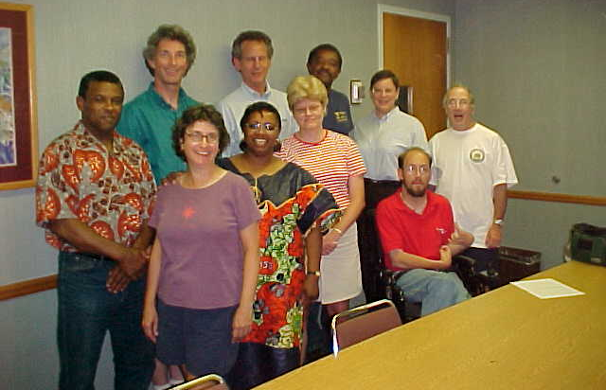
Community Coalition for Social Justice

Slide 3
Community Coalition for Social Justice
Mission
CCSJ’s mission is to bring together people from throughout the Morgantown and nearby areas dedicated to promoting the principles of social, environmental, and economic justice.

Slide 4
Community Coalition for Social Justice
Human Rights and Civil Rights
Initially we lobbied on behalf of the Civil Rights Team Project, a program of the Civil Rights Division of the West Virginia Attorney General’s office to address bullying and discrimination in schools.

Slide 5
Community Coalition for Social Justice
Human Rights and Civil Rights
CCSJ members revised the City of Morgantown’s ordinance to establish a Human Rights Commission in 2001.

Slide 6
Community Coalition for Social Justice
Human Rights and Civil Rights
Since then, we have supported the commission’s work to make Morgantown a more inclusive city by endorsing their resolutions on marriage equality; the Rights of Immigrants, Refugees and Asylees; non-discrimination in housing and employment; and the importance of welcoming everyone to the Morgantown area.

Slide 7
Community Coalition for Social Justice
Human Rights and Civil Rights
We have publicly supported the Morgantown City Council’s proposed resolutions on land acknowledgement, Indigenous People’s Day, and CROWN non-discrimination efforts, as well as Council’s establishment of the Civilian Police Review and Advisory Board.

Slide 8
Community Coalition for Social Justice
Human Rights and Civil Rights
In 2003, we testified at the public hearing that the West Virginia Advisory Committee to the U.S. Commission on Civil Rights held at the WVU College of Law.

Slide 9
Community Coalition for Social Justice
Martin Luther King Jr. Celebration Events
From 2007 through 2023, we conducted family-friendly annual Martin Luther King Jr. Day Celebrations, mostly at the Metropolitan Theatre in Morgantown.

Slide 10
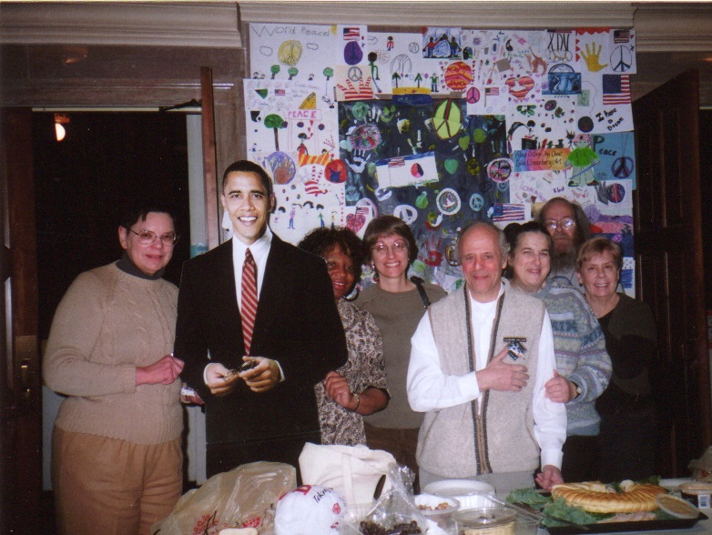
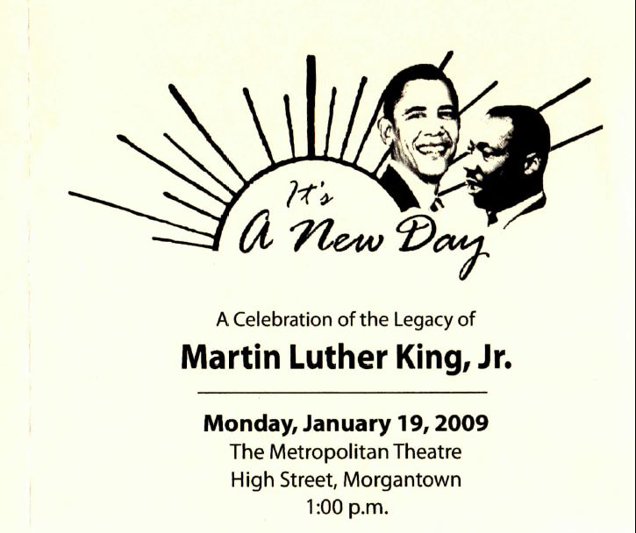
Community Coalition for Social Justice
MLK Jr. Day 2009
ʺIt’s a New Dayʺ

Slide 11
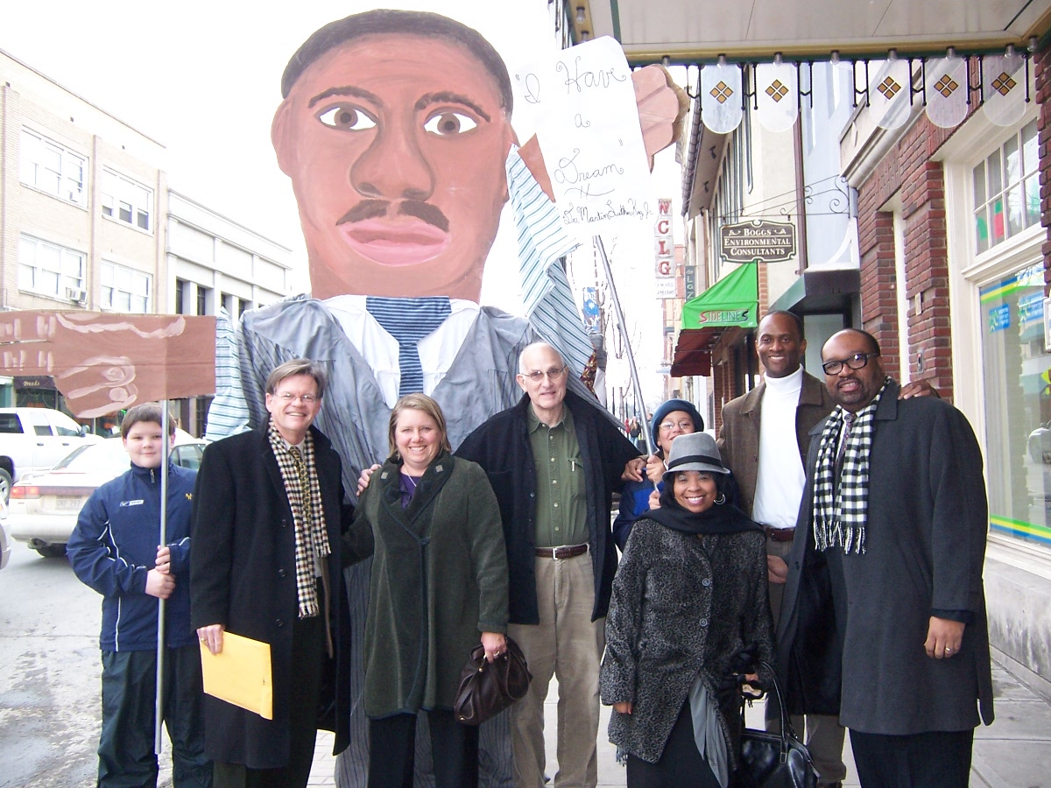
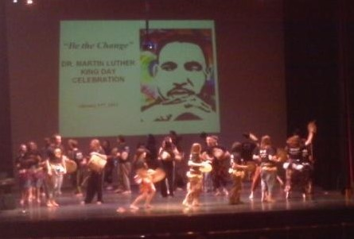
Community Coalition for Social Justice
MLK Jr. Day 2011 ʺPeaceʺ

Slide 12
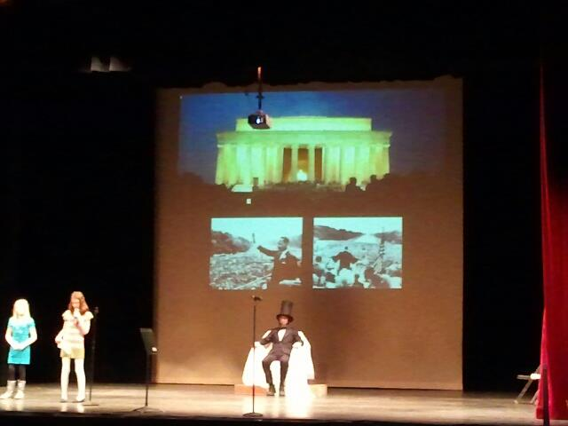
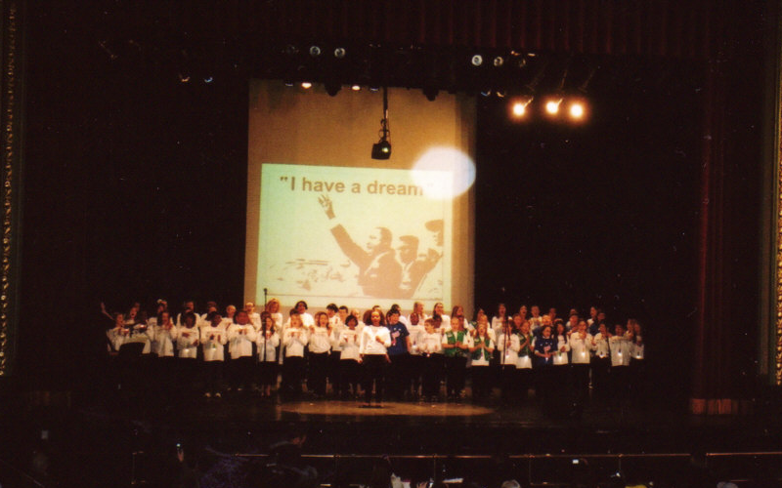
Community Coalition for Social Justice
MLK Jr. Day 2013
ʺHand in Hand, Together We Canʺ

Slide 13
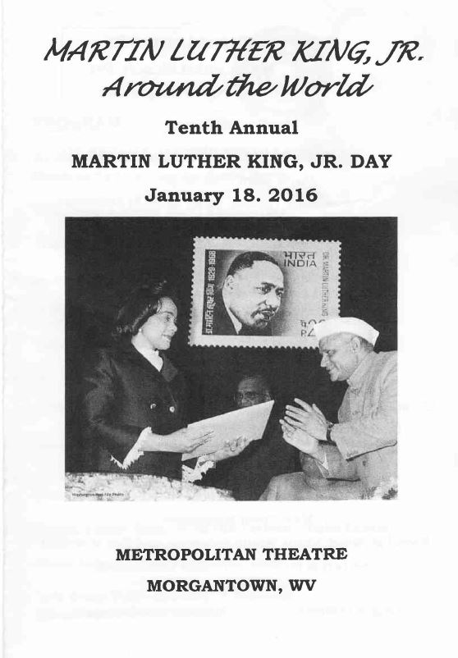
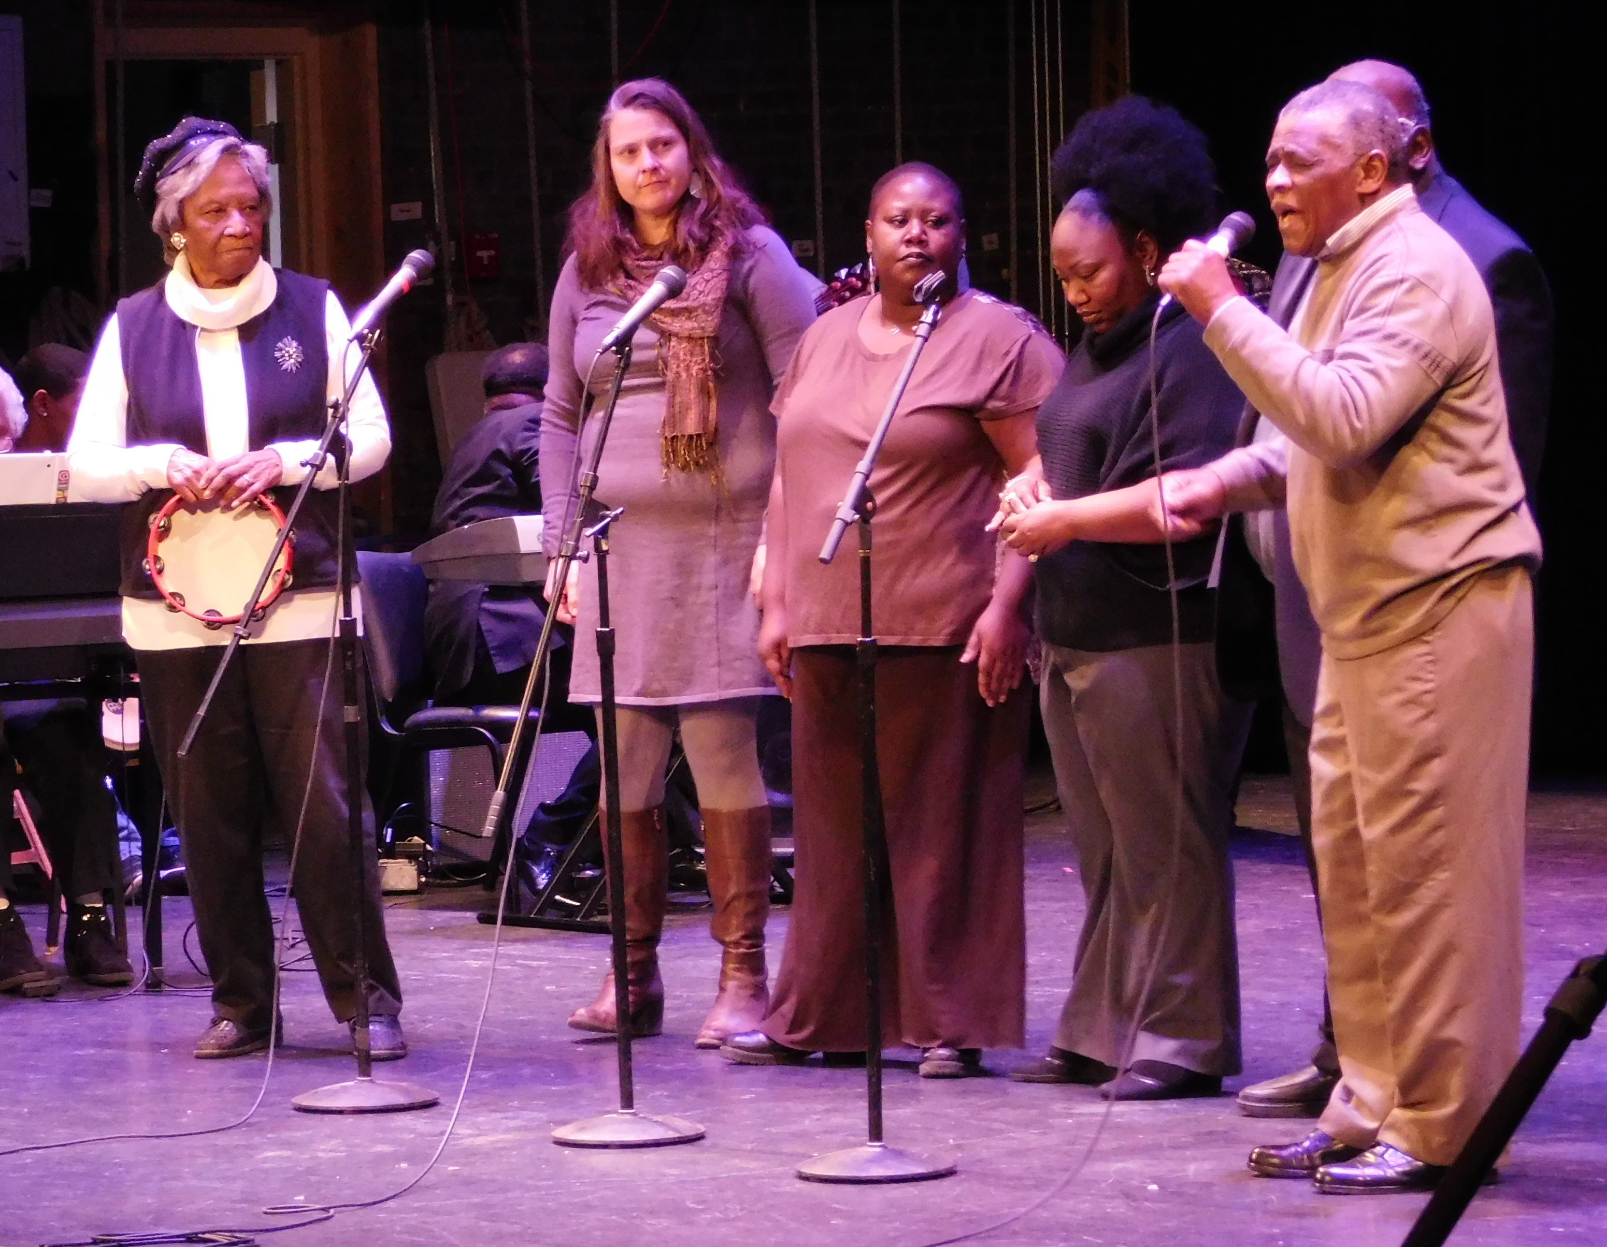
Community Coalition for Social Justice

Slide 14
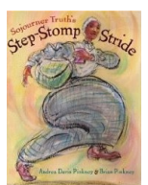
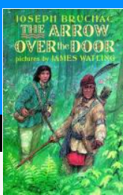
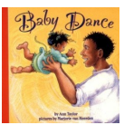
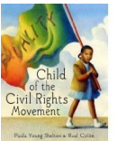
Community Coalition for Social Justice
Books
We organized the acquisition of books with funds from the Morgantown City Council for the public library, focusing on disabilities, economic justice, the environment, women’s studies, African American studies, diversity, tolerance, and justice.

Slide 15
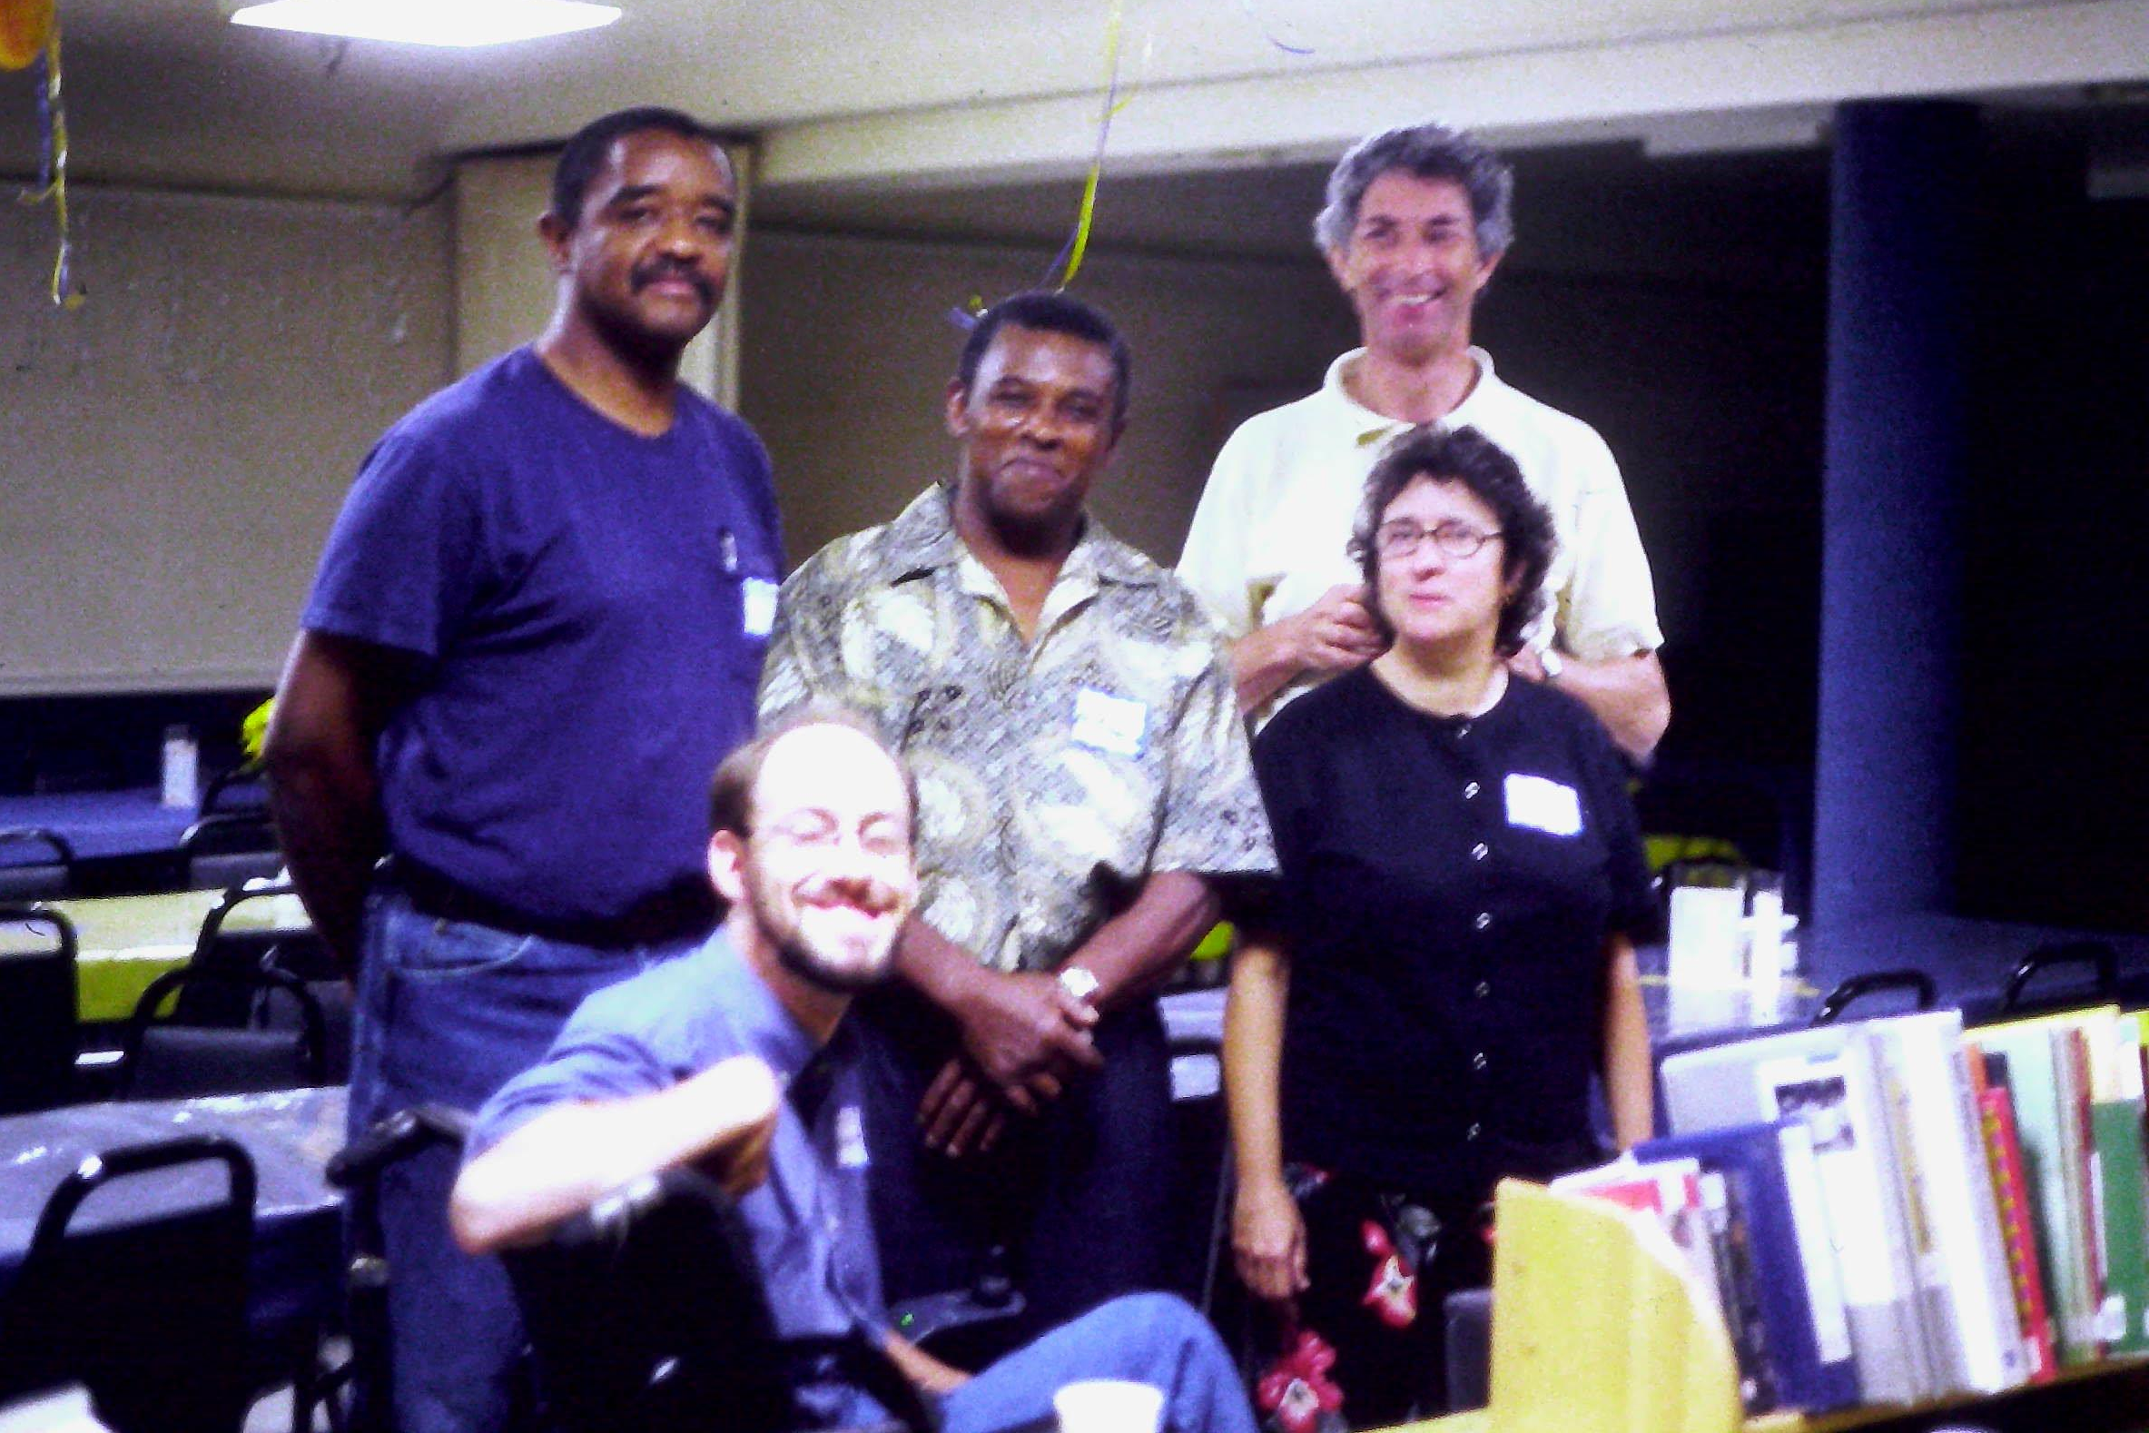
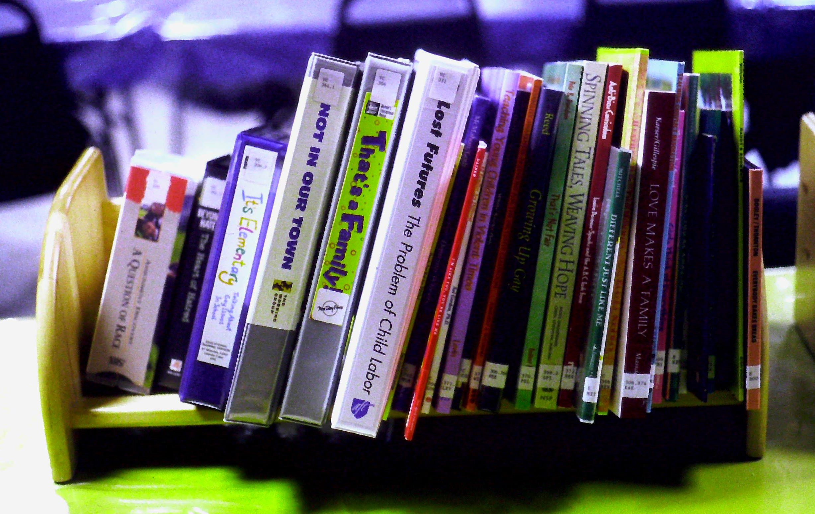
Community Coalition for Social Justice
Books

Slide 16
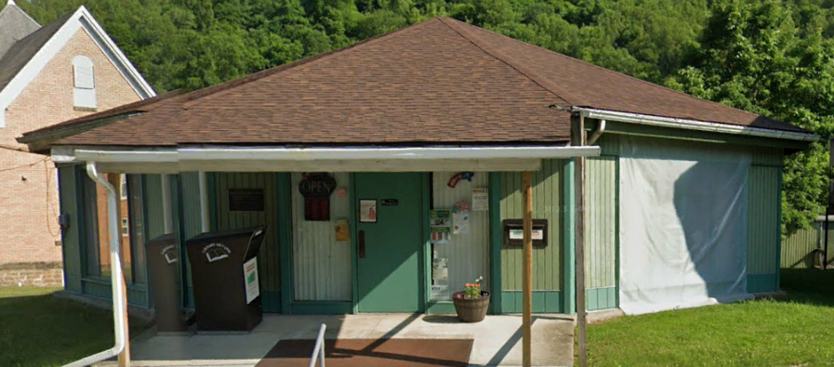
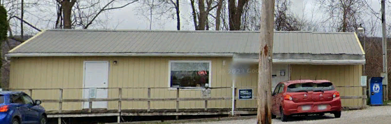
Community Coalition for Social Justice
Books
With a grant from the Appalachian Community Fund, we purchased similar books for the Clay-Battelle and Clinton District Libraries.

Slide 17
Community Coalition for Social Justice
Organized Events
An economic and social justice organization fair at First Presbyterian Church in 2004.
Forums on the Regional Jail in 2001, 2002, & 2009.
We helped sponsor a fair housing program focused on people with disabilities in 2010.

Slide 18
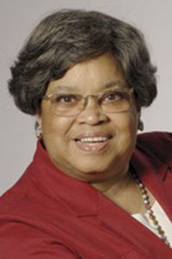
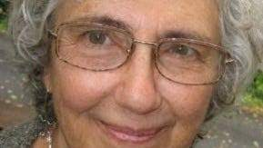
Community Coalition for Social Justice
Organized Events
In 2011, a celebration of two outstanding local women who had been active in the civil rights movement.
Charlene Marshall
Faith Holsaert

Slide 19
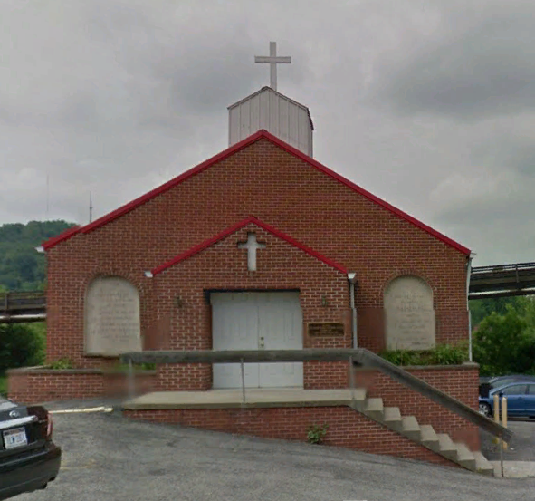
Community Coalition for Social Justice
Organized Events
A Religious Diversity Forum at the Greater St. Paul AME Church in Morgantown in 2014.

Slide 20
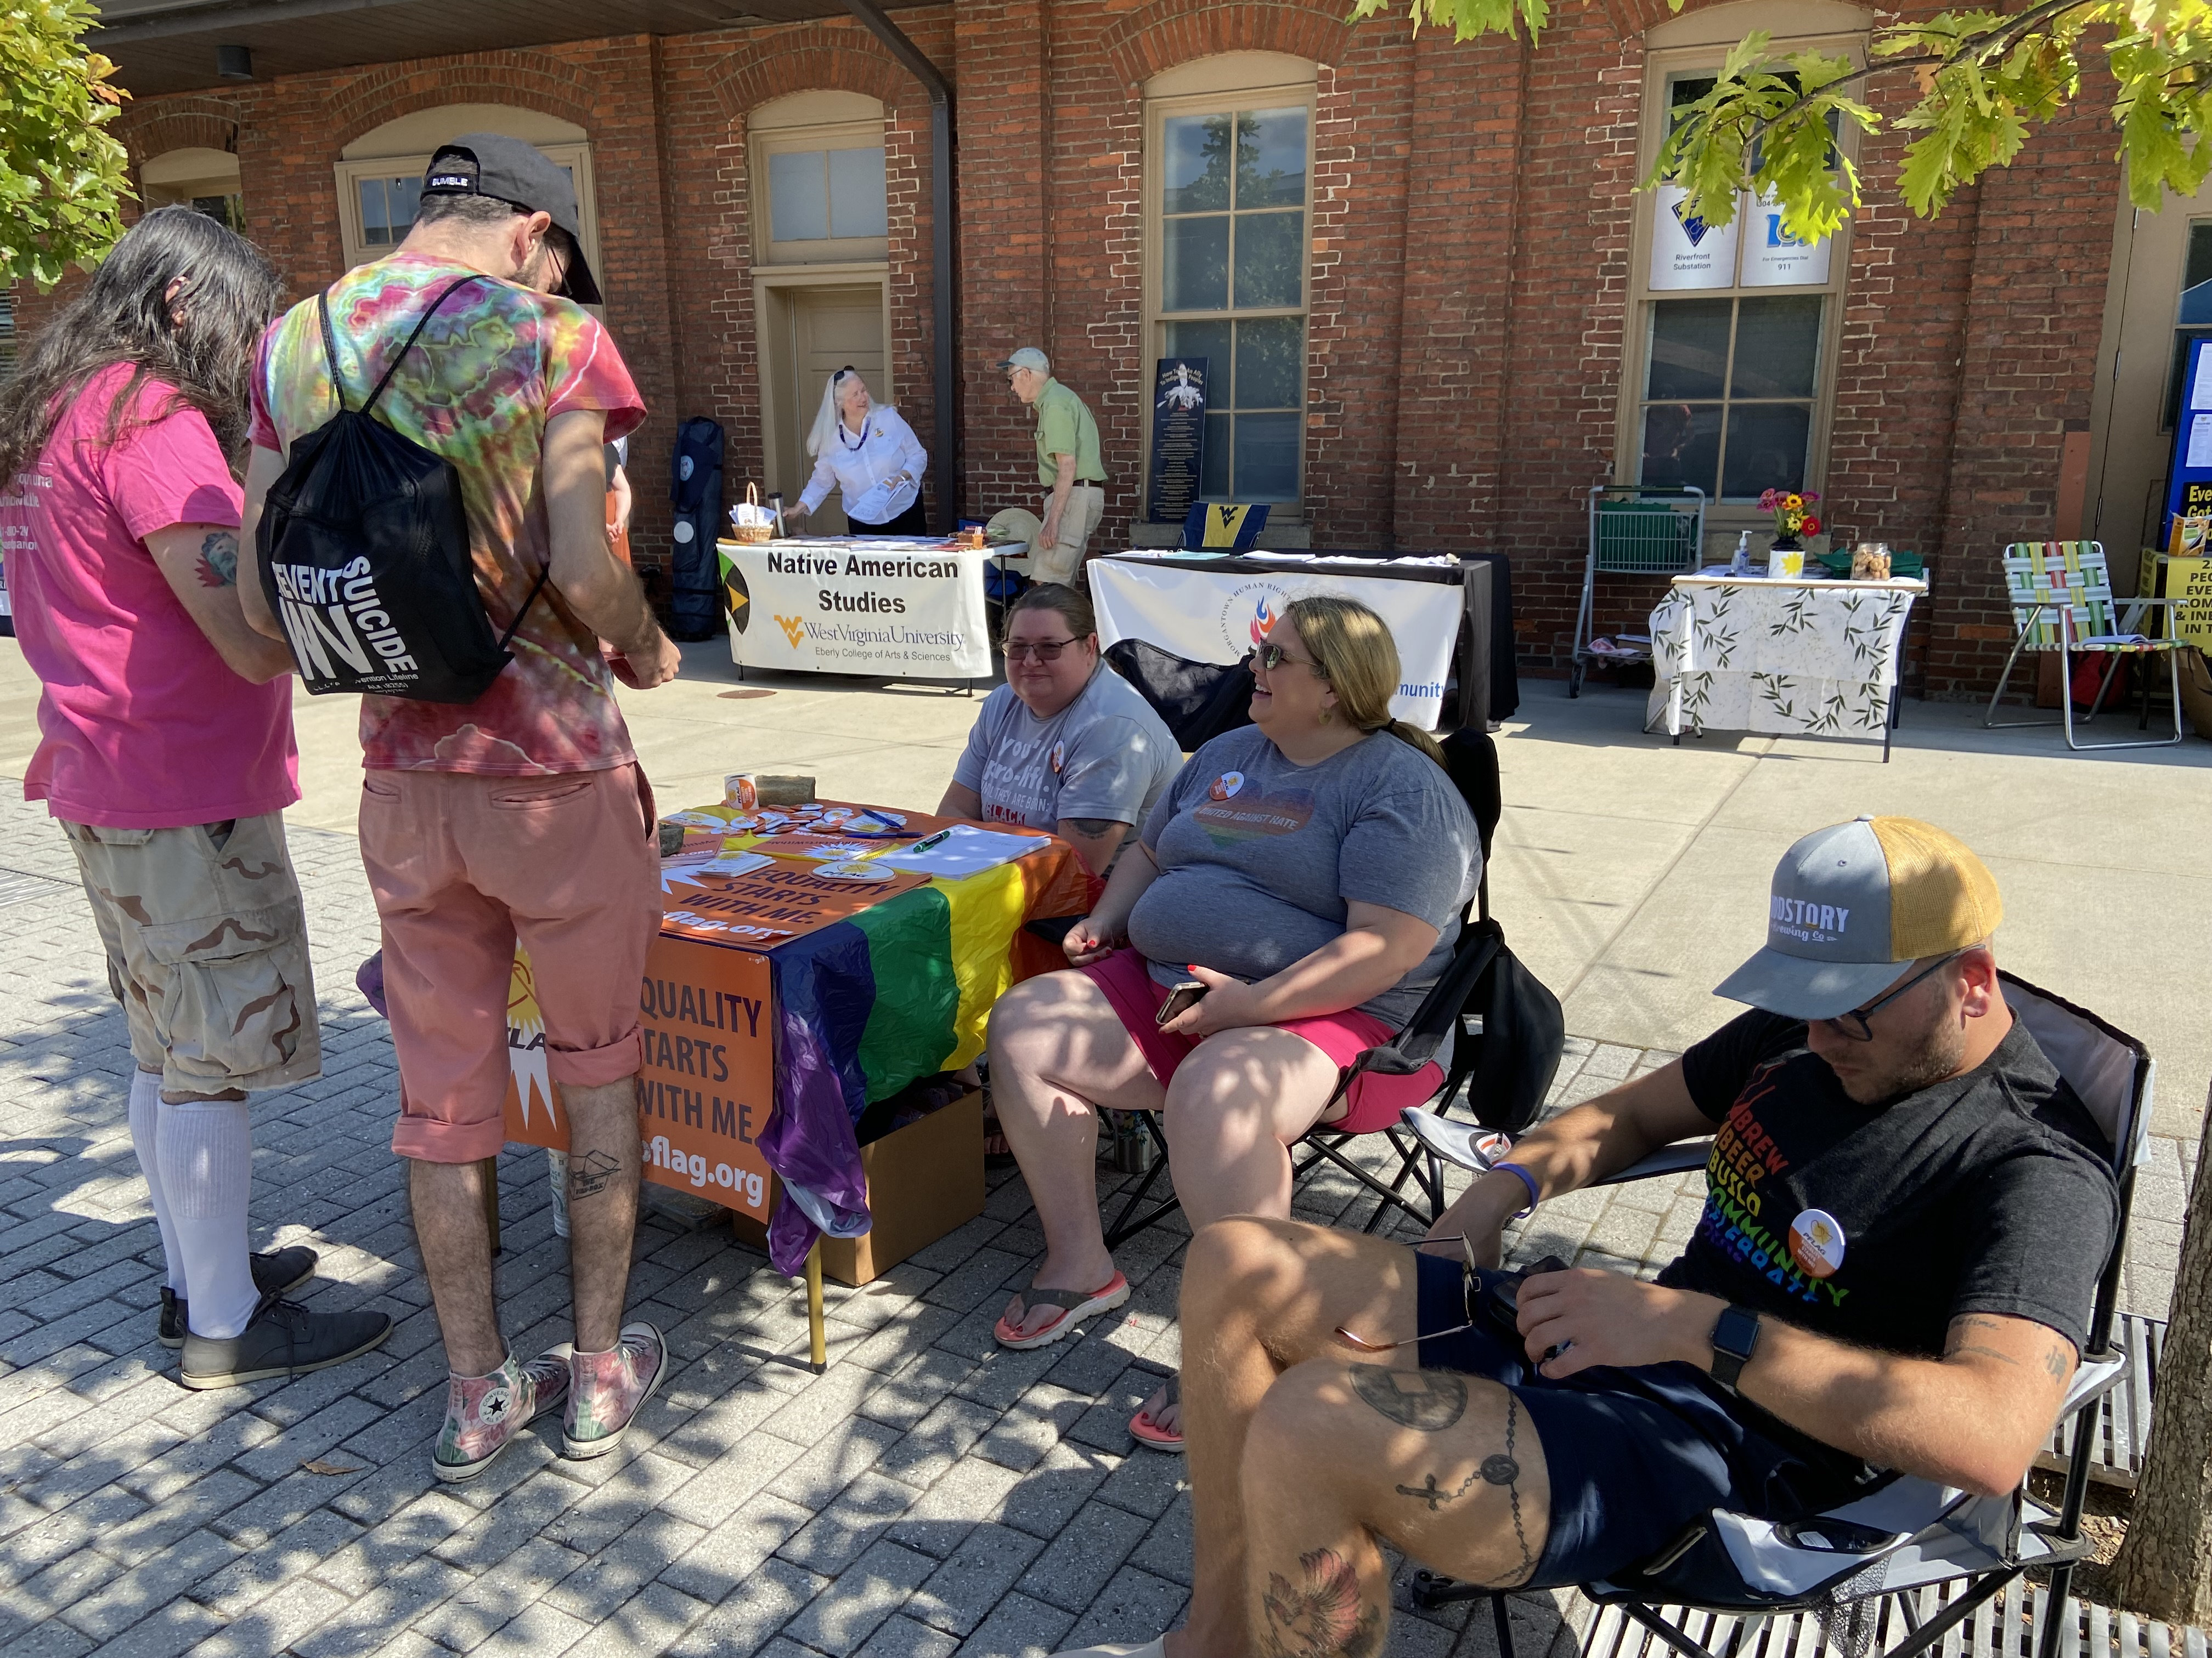
Community Coalition for Social Justice
Organized Events
A Social and Environmental Justice Fair at the Hazel Ruby Amphitheater in 2022.

Slide 21
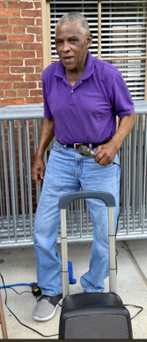
Community Coalition for Social Justice
Arts
In 2002, we held a program by Al Anderson– “Sunday Afternoon with Al: A Program in Song and Story about Growing up on Scotts Run.”

Slide 22
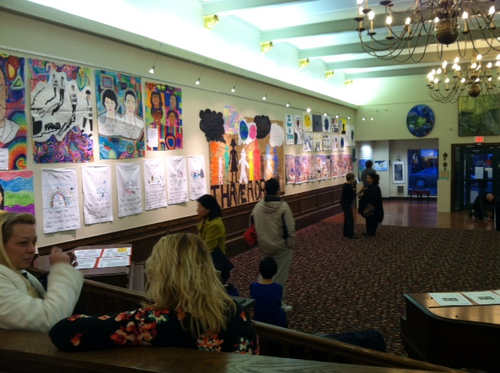
Community Coalition for Social Justice
Arts
In 2013 and 2014, we had art exhibits at Arts Mon in conjunction with our Martin Luther King Jr. Day events with art by local students.

Slide 23
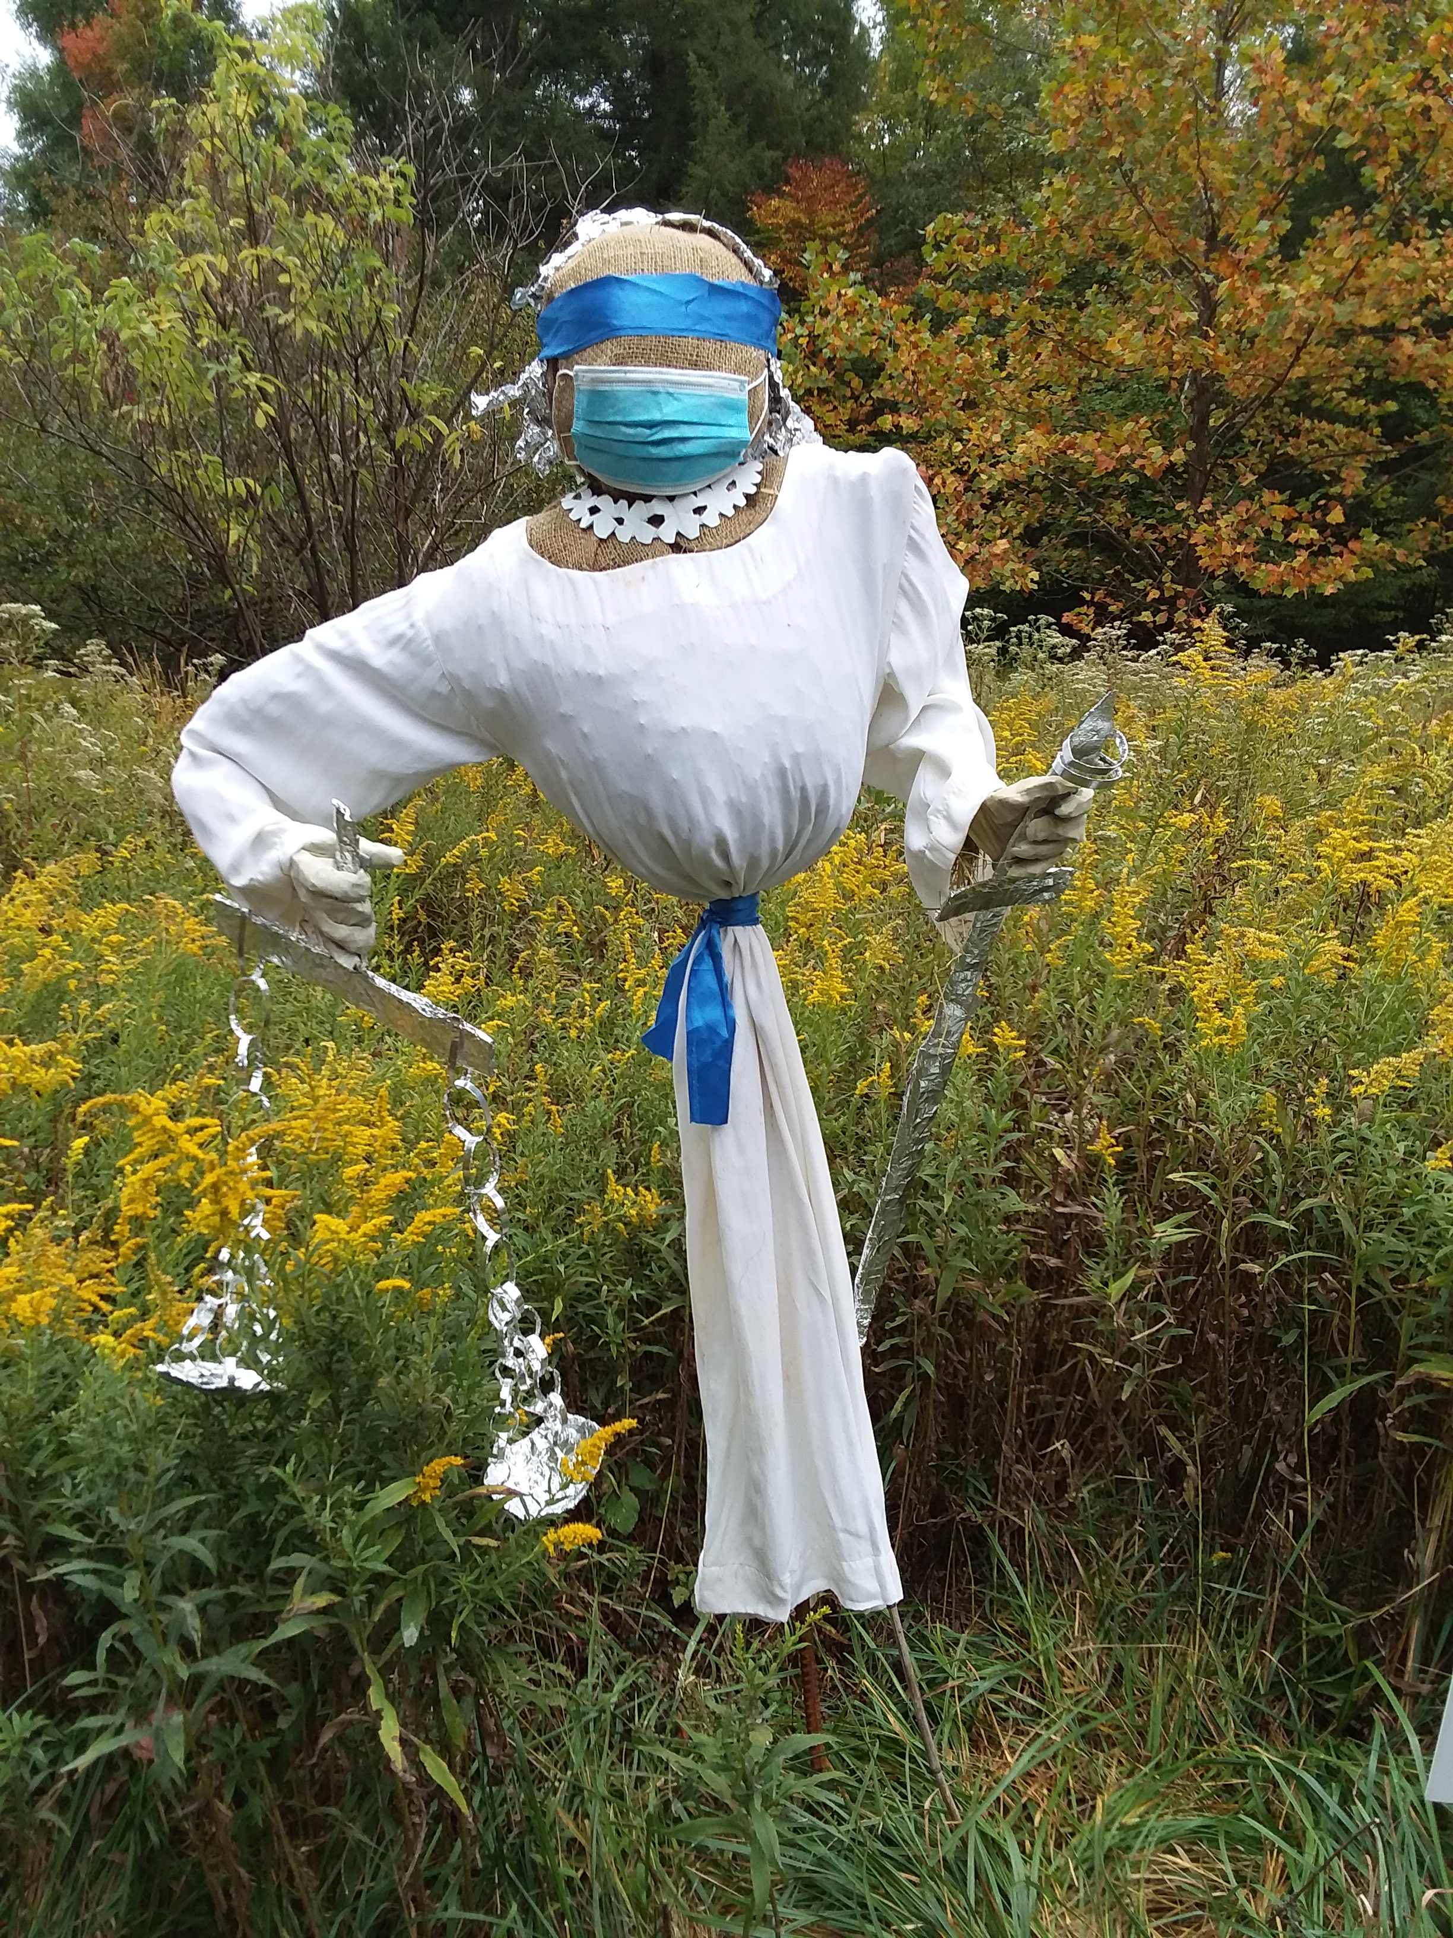
Community Coalition for Social Justice
Arts
We also put a Lady Justice scarecrow at the WV Botanic Garden to help their fundraising and membership drive.

Slide 24
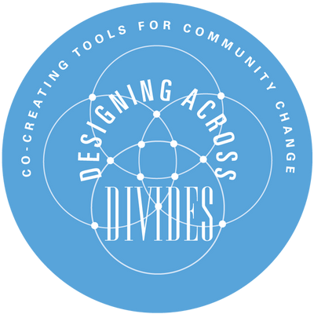
Community Coalition for Social Justice
Working with Other Groups
We supported the “Designing Across Divides” conference at WVU in 2019.

Slide 25
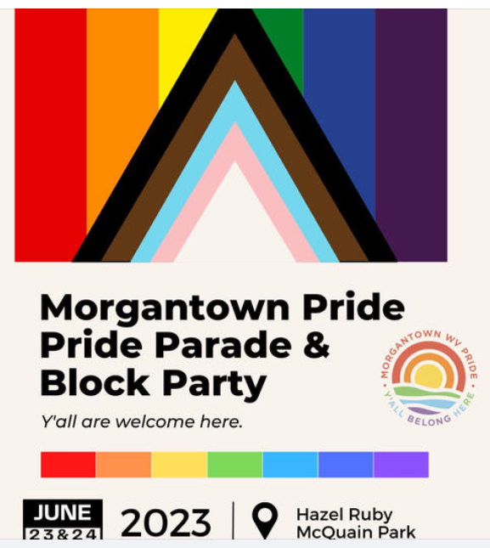
Community Coalition for Social Justice
Working with Other Groups
We have participated in the Morgantown Pride Block Party.

Slide 26
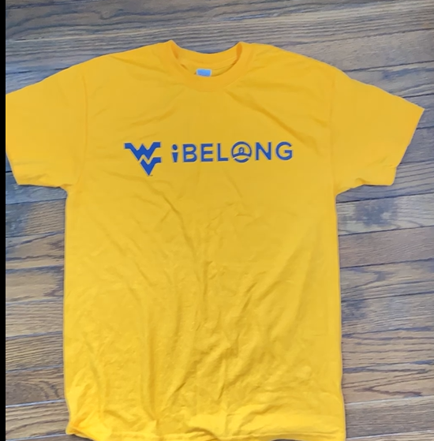
Community Coalition for Social Justice
Working with Other Groups
We participated in the 2020 WVU “I Belong” event.

Slide 27
Community Coalition for Social Justice
Working with Other Groups
We continue to publicize the work of the Greater Morgantown Interfaith Association, NAACP, WVU Native American Studies Program, WVU LGBTQ Center, Dismantling Racism Together, PFLAG, and other groups.

Slide 28
Community Coalition for Social Justice
Working with Other Groups
With the local NAACP group we continue to publicize and support the work of the League of Women Voters in organizing and running the local election Candidates Nights.

Slide 29

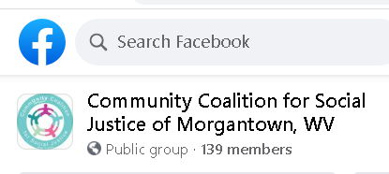
Community Coalition for Social Justice
Publicity
We distribute a monthly e-newsletter, have a website at ccsjwv.org, and a Facebook page.

Slide 30


Community Coalition for Social Justice
Funding
We appreciate financial support received from the City of Morgantown and FirstEnergy Foundation for our projects.

Slide 31
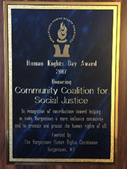
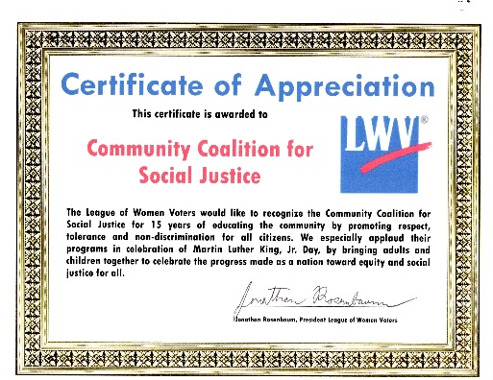
Community Coalition for Social Justice
Honors
We were honored to receive one of the Morgantown/Monongalia County League of Women Voters’ first social justice awards in 2015 and received recognition from the Morgantown Human Rights Commission in 2017.

Slide 32
Community Coalition for Social Justice
The Future
We hope through our actions and the support of so many people in the community that we will continue to address issues of social justice to keep Morgantown a welcoming, open, inclusive community dedicated to treating one another with civility and respect.

